Slide 1
TEAM 4
Julian, Ruomu, Shaun, Riwu

Slide 2
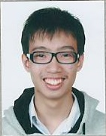
Julian

Slide 3
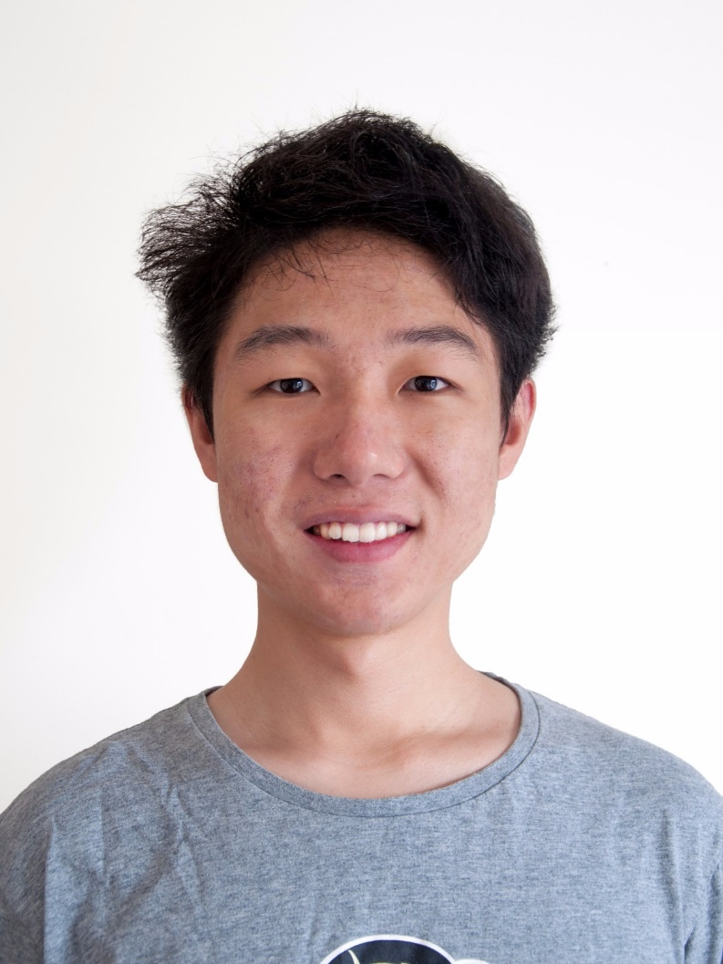
Ruomu

Slide 4
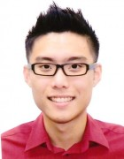
Shaun

Slide 5
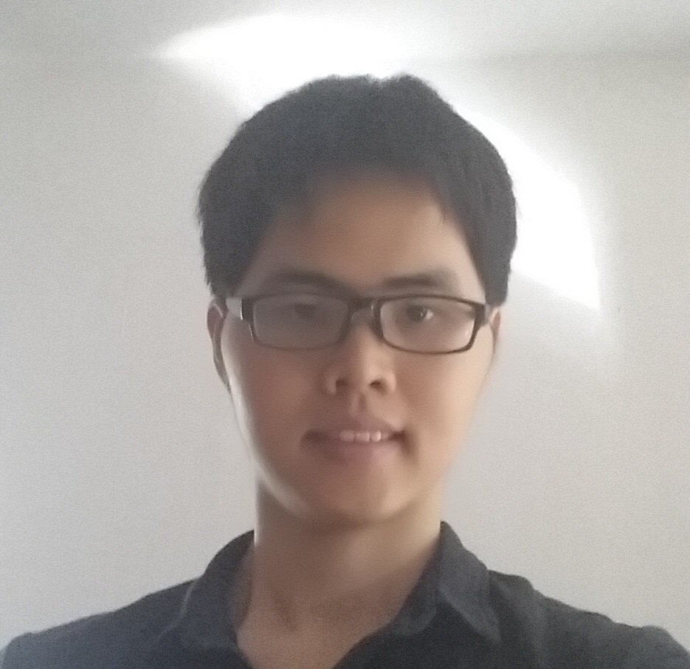
Riwu

Slide 6
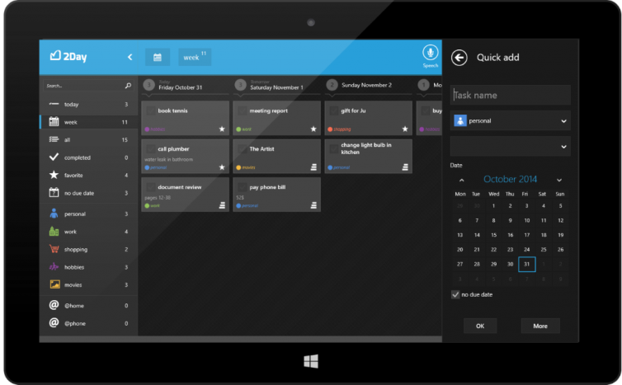
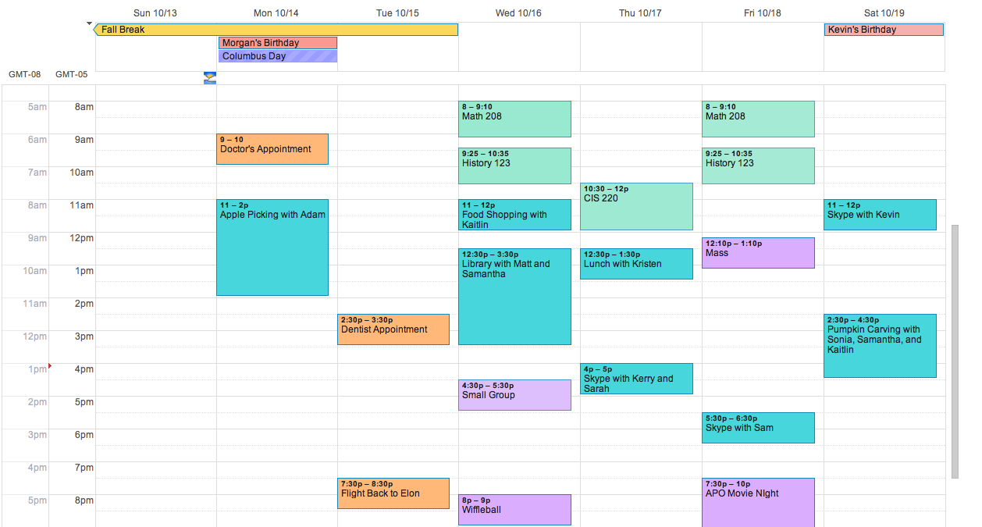
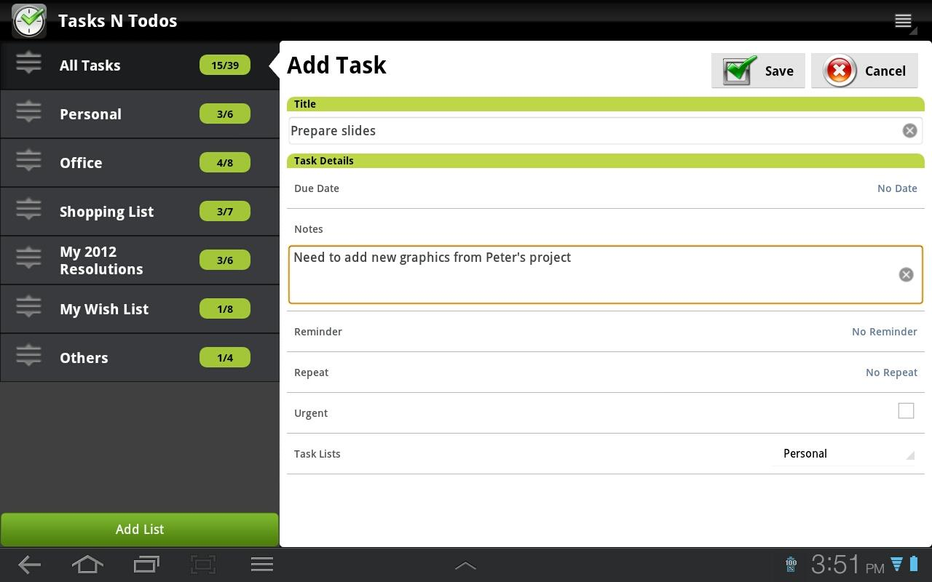
Why WURI?

Slide 7
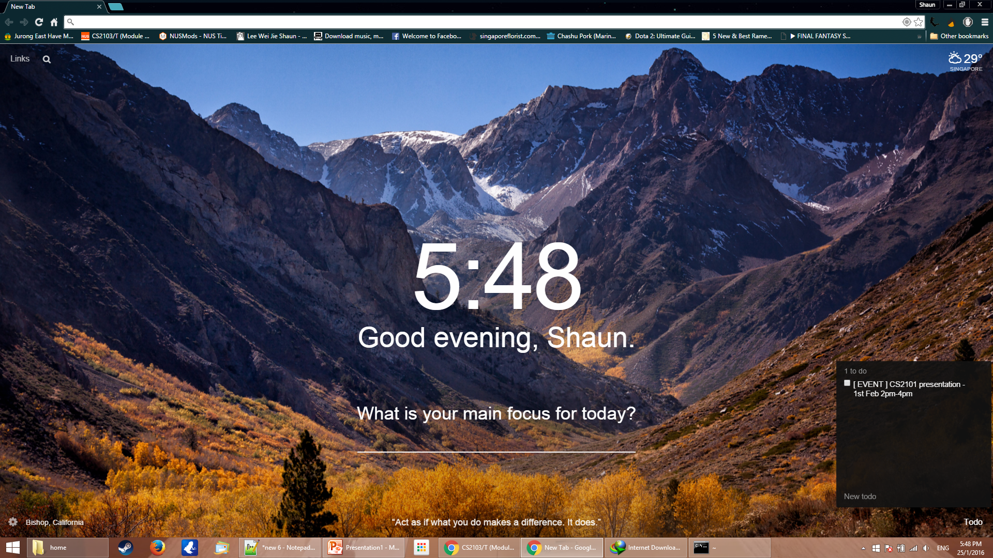
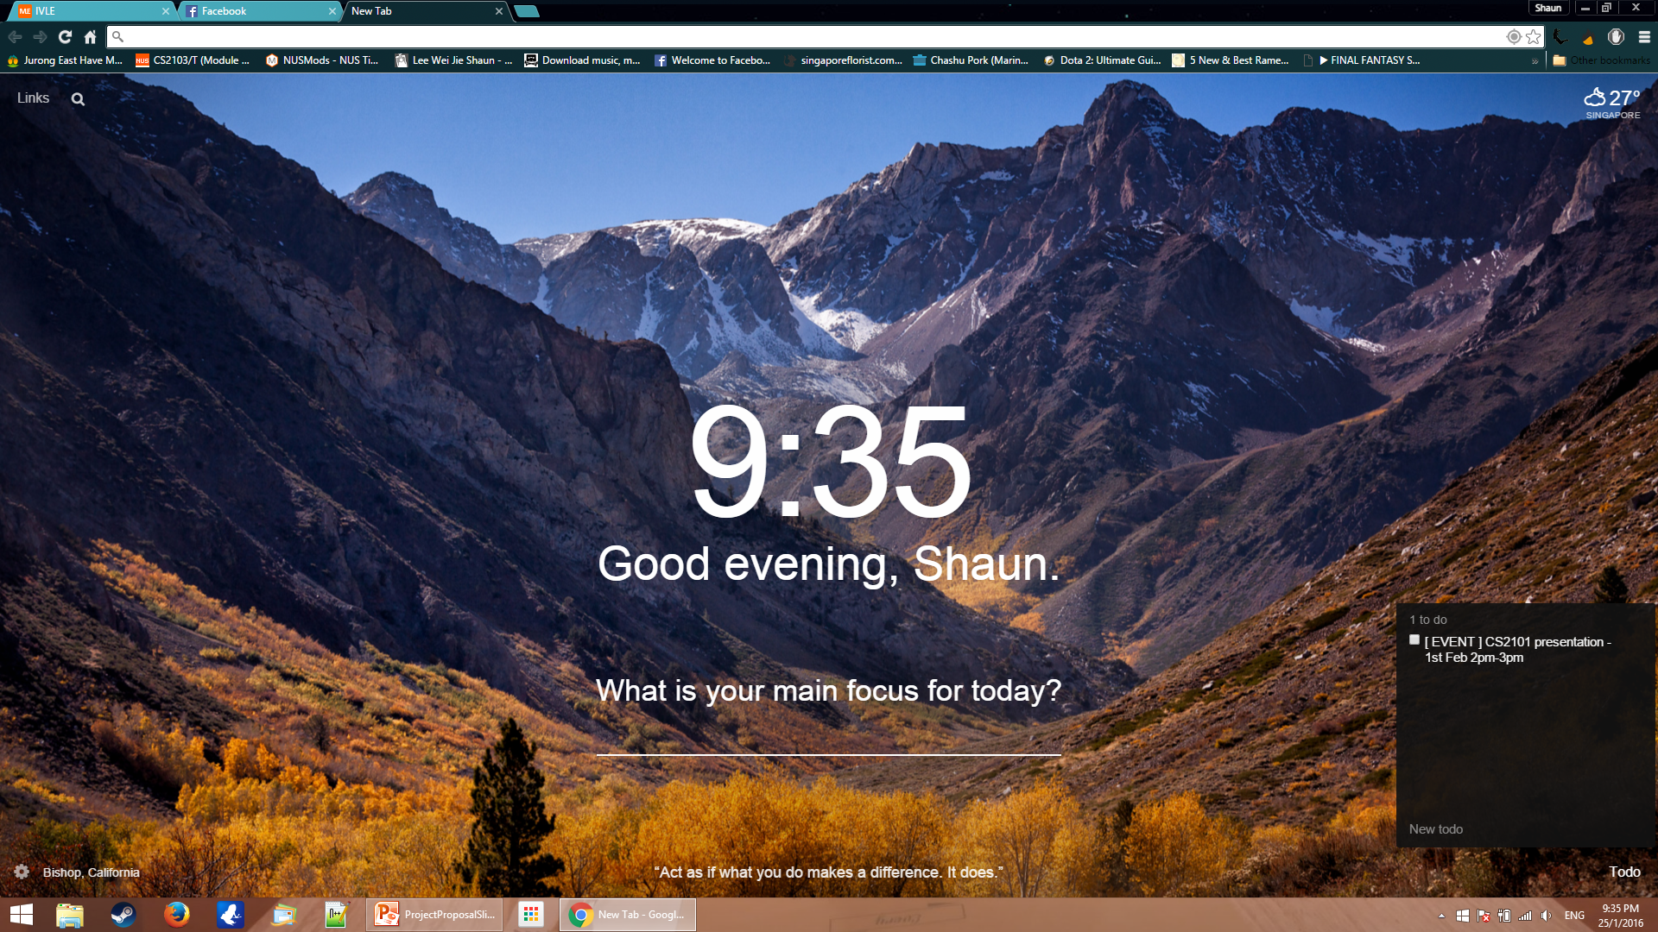
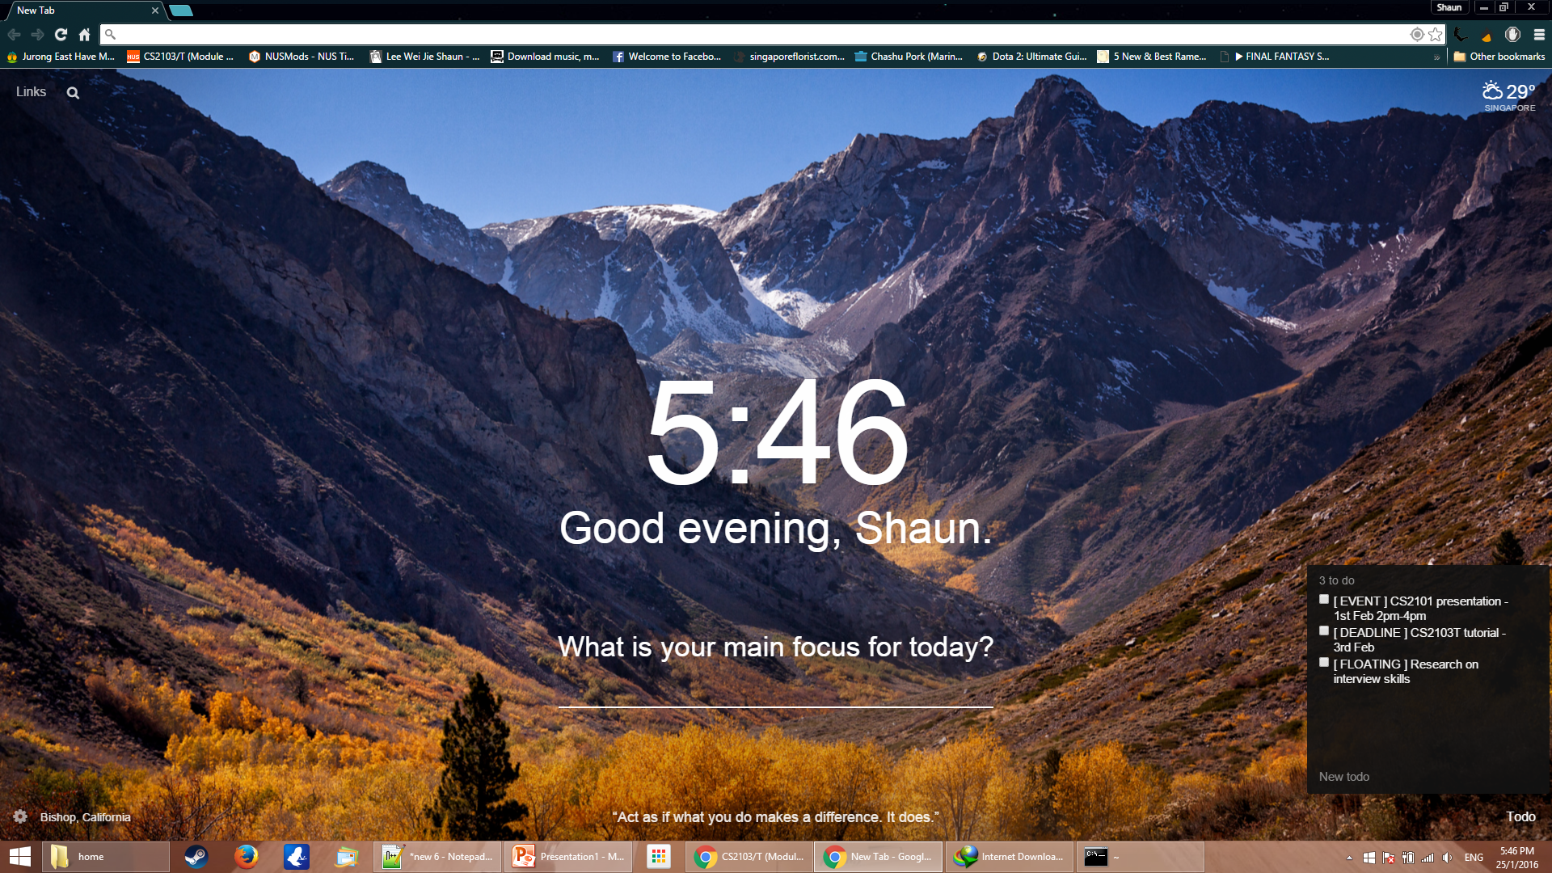
Basic Functionalities
Types of Tasks
Events (time period)
Deadlines
Floating Tasks (no specific)
CRUD
Create
Retrieve
Update
Delete

Slide 8
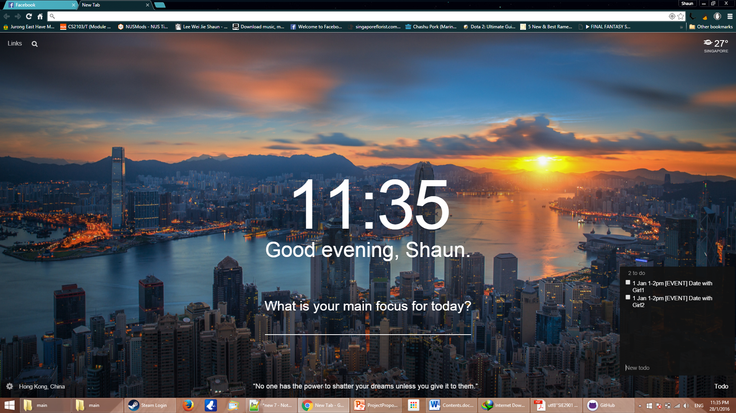

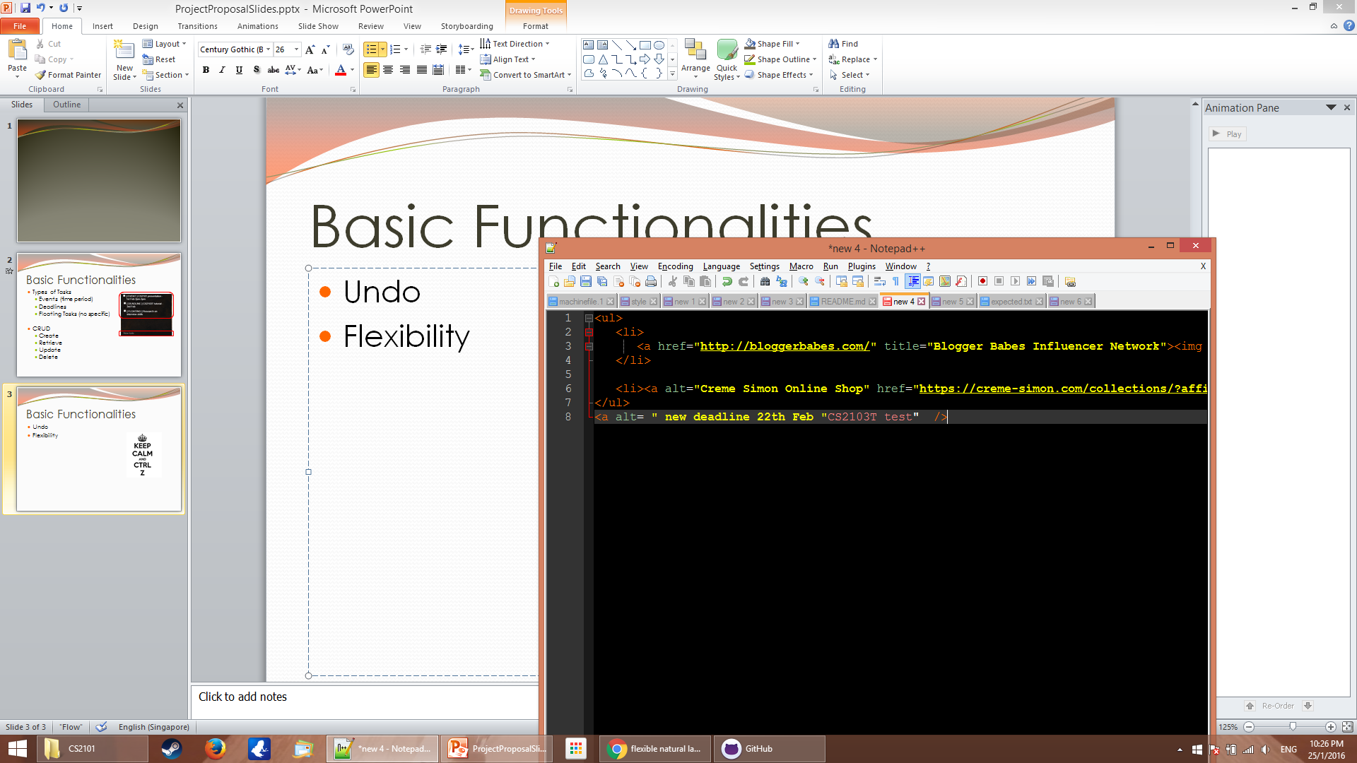
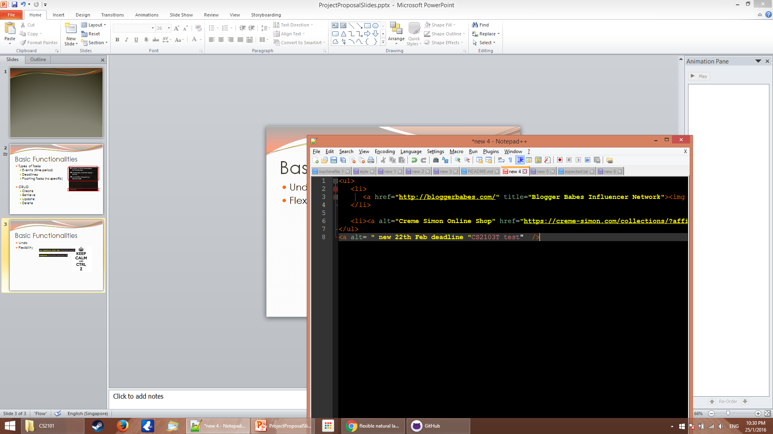


Basic Functionalities
Undo
Flexibility
Accessibility

Slide 9
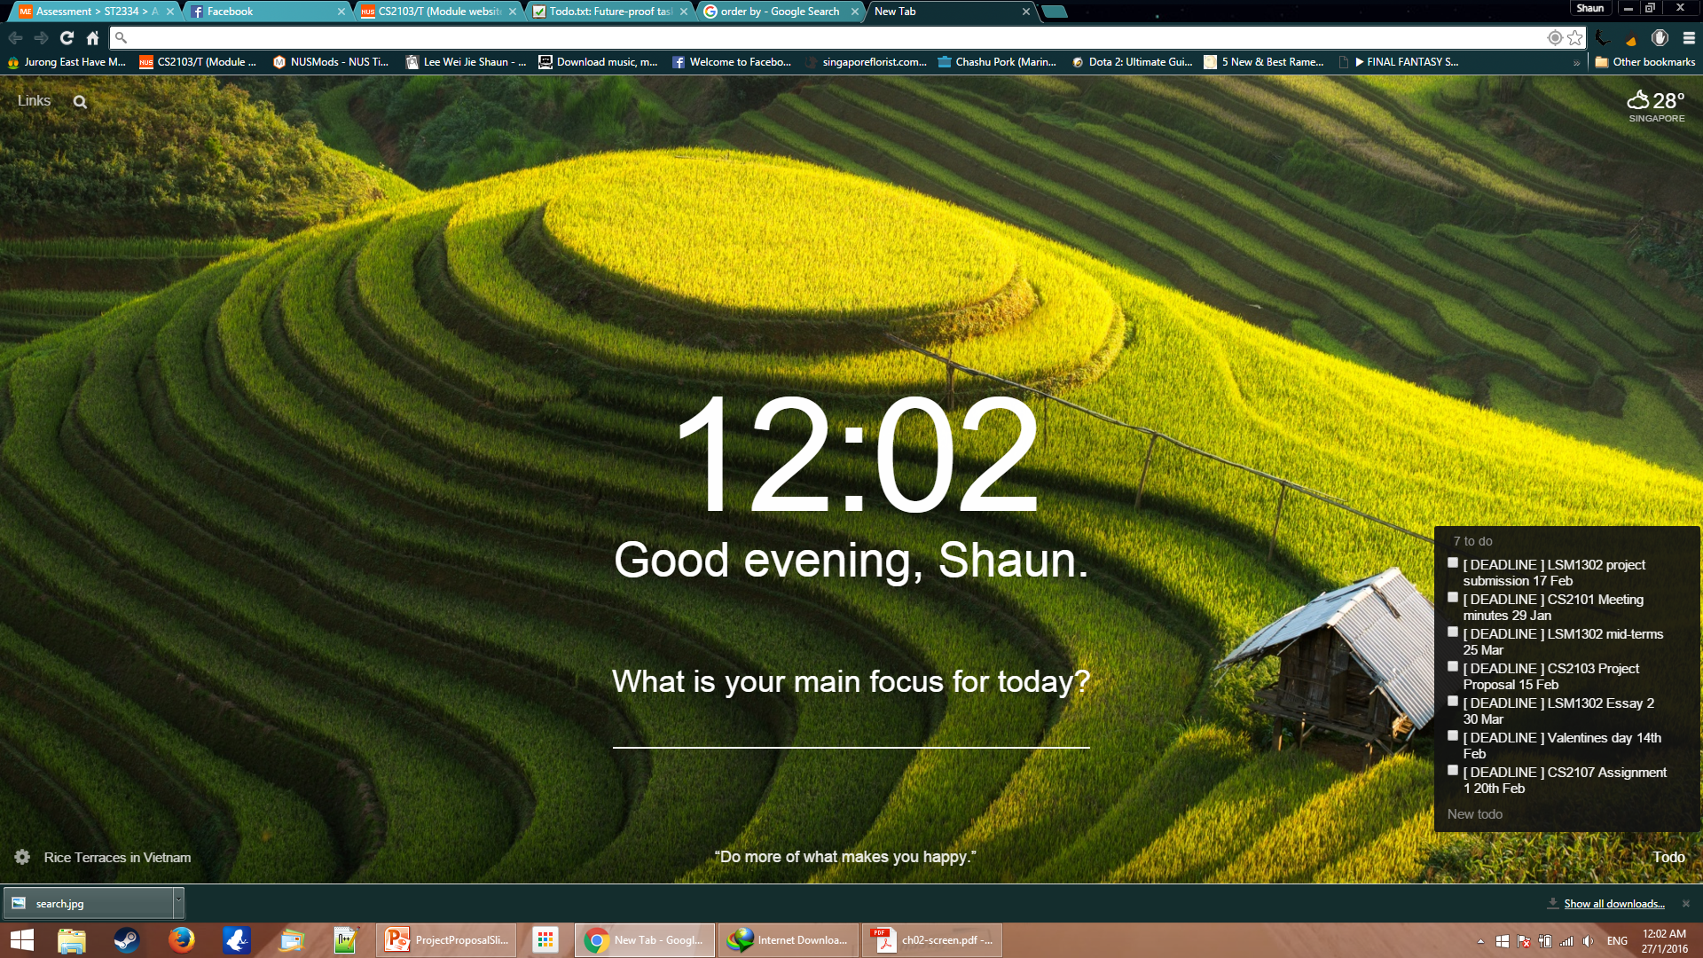

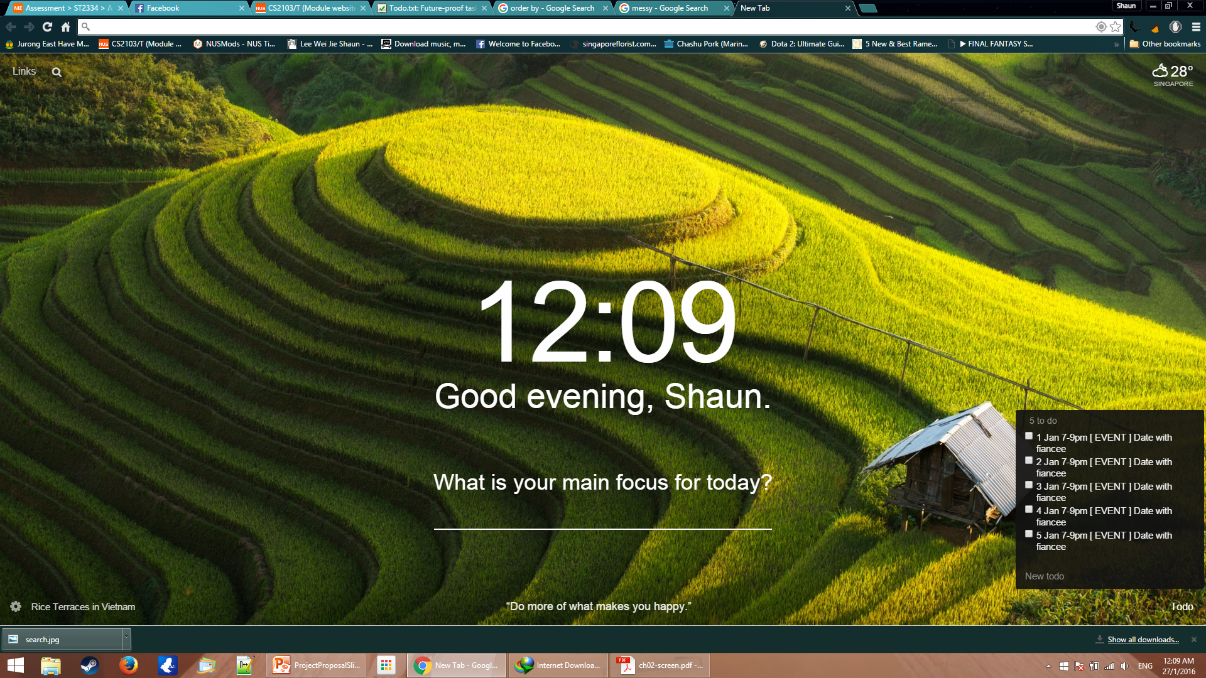
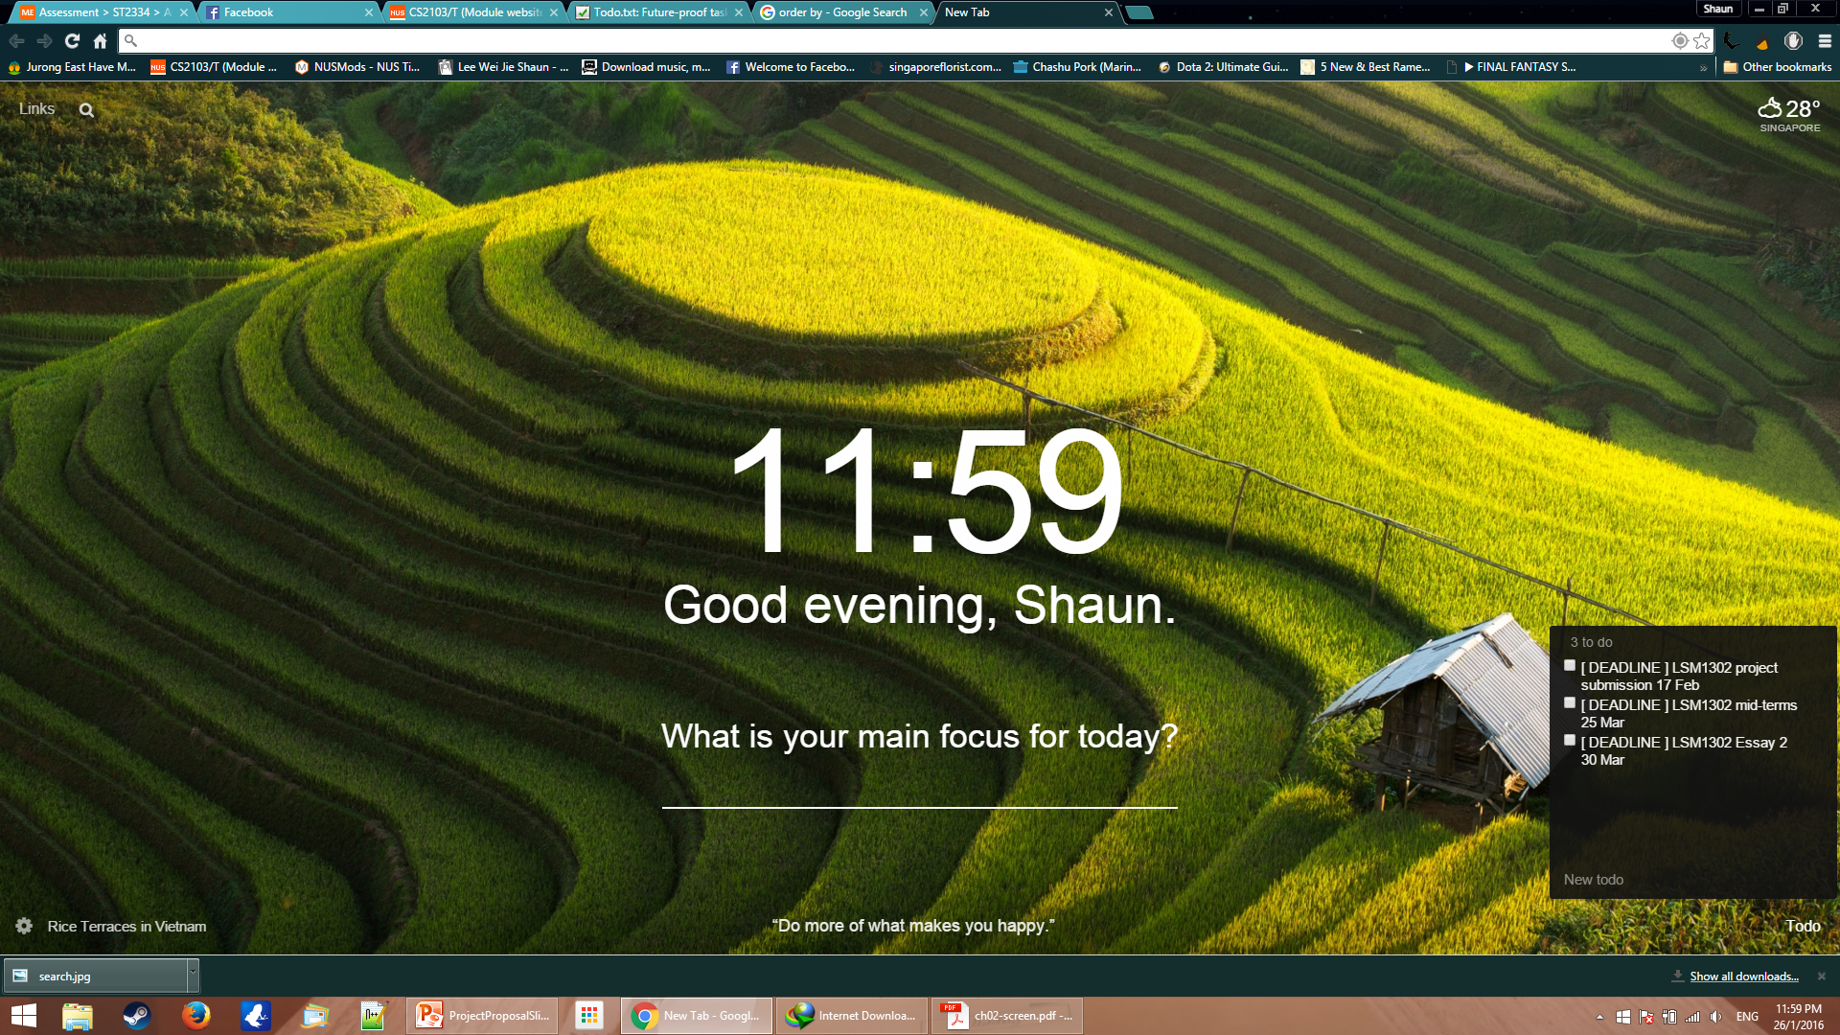
Basic Functionalities
Searching
Sorting
LSM1302

Slide 10
Extra Functionalities(basic)
Recurring tasks
add CS2103T meeting -rw 01256 -t 5pm
Weekly Recurring
Recurring period | Command
Every x days | -rd 4
Weekly (Sun-Sat: 0-6) | -rw 035
Monthly | -rm 21
Yearly | -ry 27.03

Slide 11
Extra Functionalities(basic)
Hot-key call out
Ctrl + Alt + Space

Slide 12
Extra Functionalities(basic)
Short-cut for keywords
add CS2103T meeting -t 15:00 -d 10.02.2016
All alias starts with underscore
add _3t _m –t 3pm –d 10

Slide 13
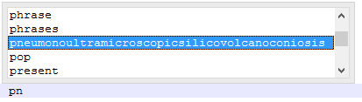
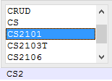
Extra Functionalities(Advanced)
Autocomplete & autocorrect

Slide 14
Extra Functionalities(Advanced)
Encryption
password for locker 323324
password for locker ******

Slide 15
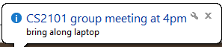

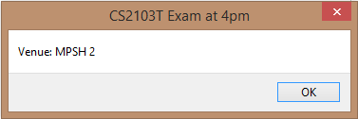
Extra Functionalities(Advanced)
Notification / Alarm

Slide 16

Extra Functionalities(Advanced)
Regular Expression search
IS\d
IS, followed by a digit

Slide 17
References
https://cis220fall13.files.wordpress.com/2013/10/screen-shot-2013-10-10-at-4-07-23-pm.png
http://beta.2day-app.com/wp-content/uploads/2014/10/WinWP-1024x467.png
https://lh3.ggpht.com/NS5paCpLK2QRVJHnvLMXwCWTKiWP4Drrb0s8QZCt1z3tdUqhBzQbMcFa4B3hoI4epw=h900
http://vignette4.wikia.nocookie.net/animal-jam-clans-1/images/b/ba/Shocked-emoji.png/revision/latest?cb=20151106210259

